Slide 1
Introduction to Calculus
Precalculus
Chapter 12

Slide 2
This Slideshow was developed to accompany the textbook
Precalculus
By Richard Wright
https://www.andrews.edu/~rwright/Precalculus-RLW/Text/TOC.html
Some examples and diagrams are taken from the textbook.
Slides created by
Richard Wright, Andrews Academy
rwright@andrews.edu

Slide 3
12-01 Introduction to Limits
In this section, you will:
Evaluate limits with a table.
Identify when limits fail to exist.
Evaluate limits by substitution.

Slide 4
12-01 Introduction to Limits
Limit
If $f\left(x\right)$ becomes arbitrarily close to a unique number L as x approaches c from either side, then the limit of $f\left(x\right)$ as x approaches c is L.
$$\lim_{x→c}{f\left(x\right)}=L$$

Slide 5
12-01 Introduction to Limits
Ways to find limits
Estimate Numerically (Table)
$$\lim_{x→−2}{\frac{x^{2}+4x+4}{x+2}}$$
$$=0$$
$$x$$ | $$f\left(x\right)$$
-2.1 | -0.1
-2.01 | -0.01
-2.001 | -0.001
-2
-1.999 | 0.001
-1.99 | 0.01
-1.9 | 0.1

Slide 6
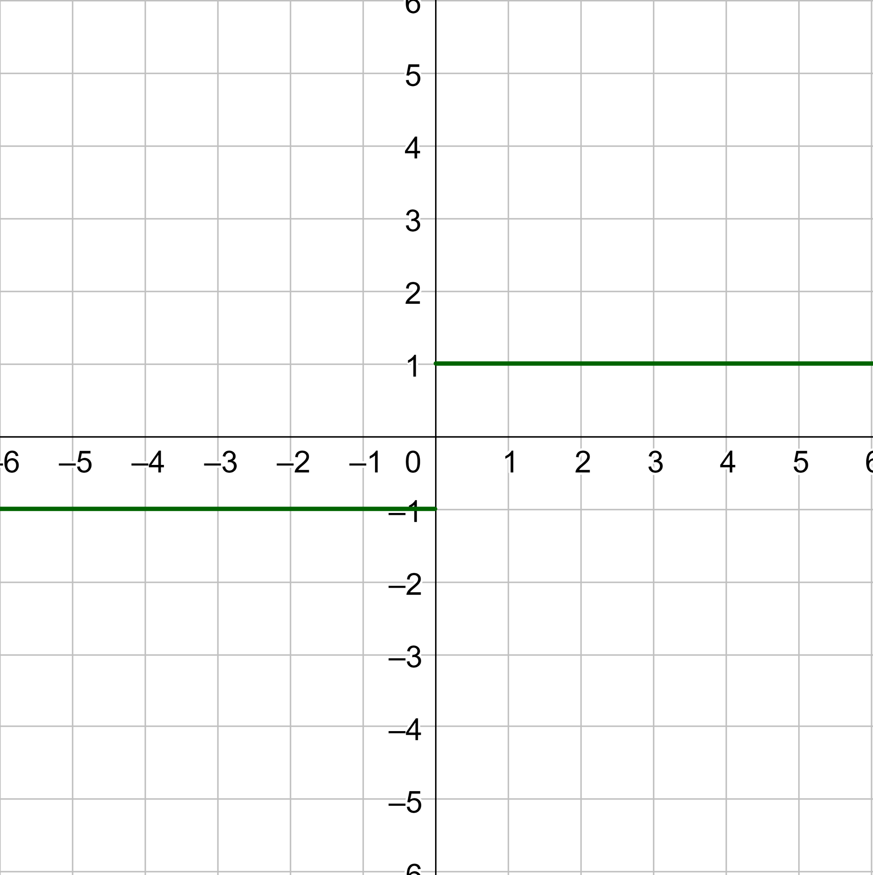
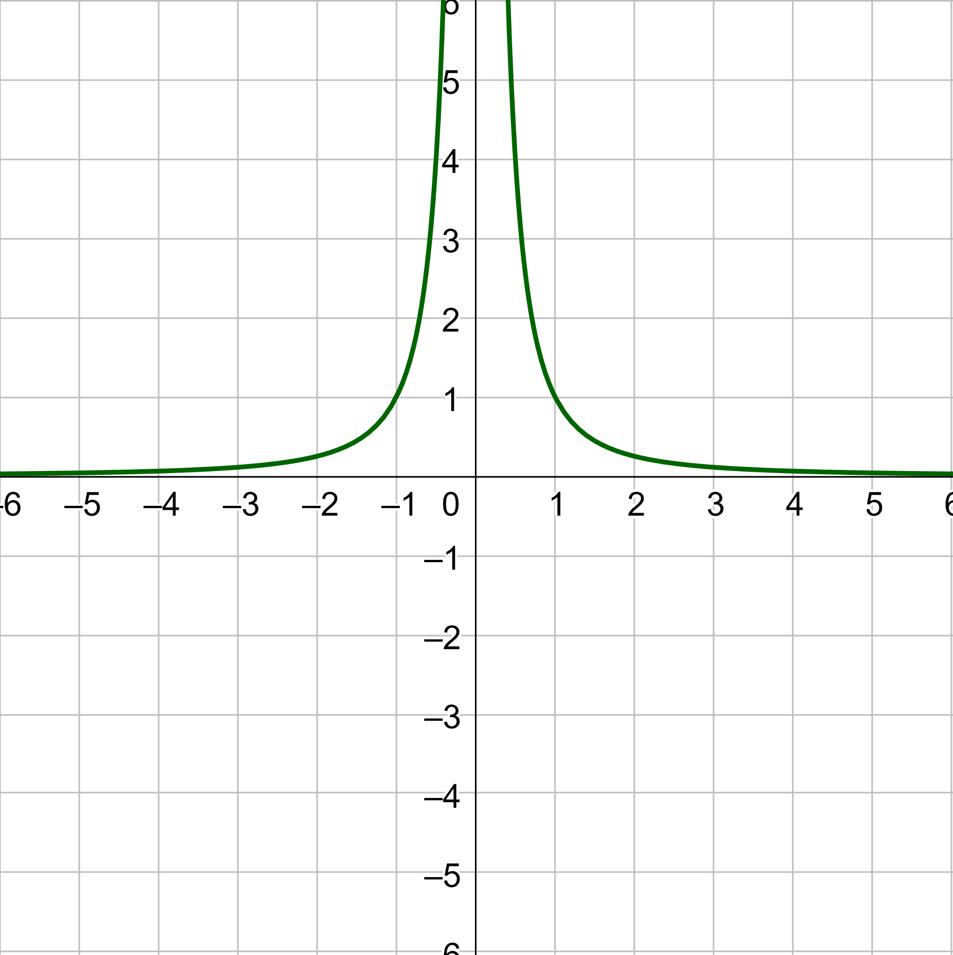
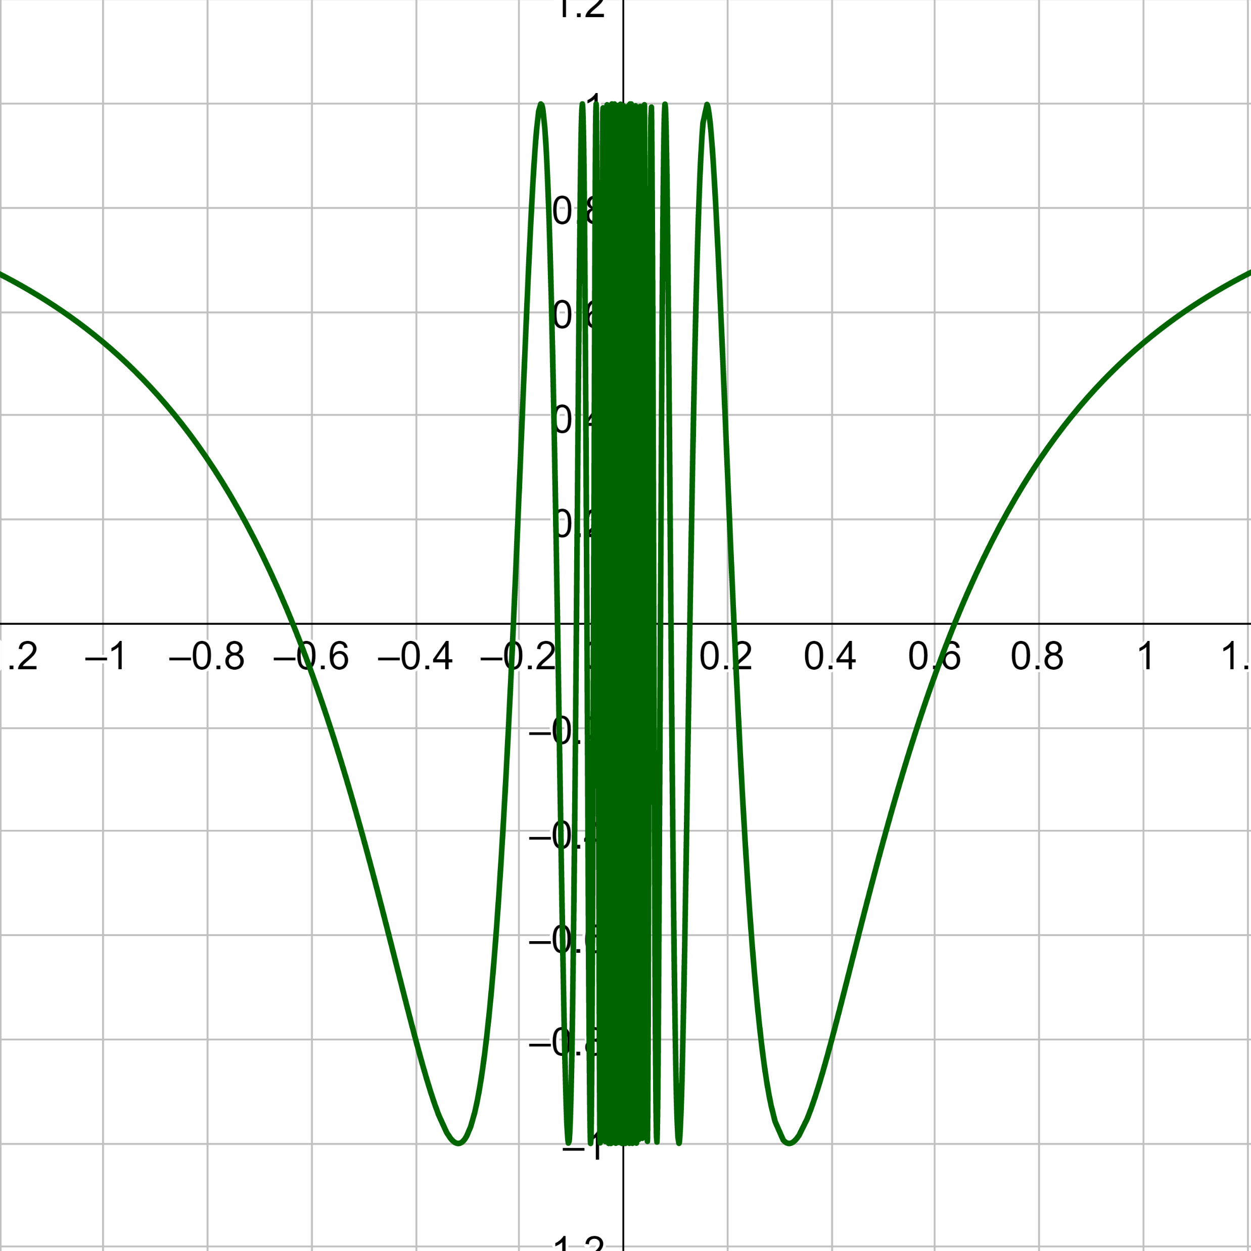
12-01 Introduction to Limits
Limits that fail to exist
$f\left(x\right)$ approaches different numbers from both sides
$f\left(x\right)$ increases of decreases without bound
$f\left(x\right)$ oscillates between 2 fixed values
$\cos\left(\frac{1}{x}\right)$

Slide 7
12-01 Introduction to Limits
Properties of Limits
$$\lim_{x→c}{b}=b$$
$$\lim_{x→c}{x}=c$$
$$\lim_{x→c}{x^{n}}=c^{n}$$
$$\lim_{x→c}{\sqrt[n]{x}}=\sqrt[n]{c}$$
Let $\lim_{x→c}{f\left(x\right)}=L$ and $\lim_{x→c}{g\left(x\right)}=K$
$$\lim_{x→c}{bf\left(x\right)}=bL$$
$$\lim_{x→c}\left[f\left(x\right)±g\left(x\right)\right]=L±K$$
$$\lim_{x→c}{f\left(x\right)g\left(x\right)}=LK$$
$$\lim_{x→c}{\frac{f\left(x\right)}{g\left(x\right)}}=\frac{L}{K}$$
$$\lim_{x→c}{{\left[f\left(x\right)\right]}^{n}}=L^{n}$$

Slide 8
12-01 Introduction to Limits
Evaluate
$\lim_{x→2}{3x^{2}}$
$\lim_{x→1}\left(4x^{3}−2x^{2}+17\right)$
$\lim_{x→2}{\frac{x^{2}−4}{x}}$
Notes:
$$=3{\left(2\right)}^{2}$$
$$=12$$
$$=4{\left(1\right)}^{3}−2{\left(1\right)}^{2}+17$$
$$=19$$
$$=\frac{{\left(2\right)}^{2}−4}{2}$$
$$=\frac{0}{2}$$
$$=0$$

Slide 9
12-02 Evaluating Limits
In this section, you will:
Evaluate limits that are indeterminant.
Evaluate one-sided limits.
Evaluate a limit from calculus.

Slide 10
12-02 Evaluating Limits
What if direct substitution give
$$\lim_{x→c}{f\left(x\right)}=\frac{0}{0}$$
called indeterminant form
Dividing out technique
Factor
Cancel common factors
Then find the limit

Slide 11
12-02 Evaluating Limits
Evaluate
$\lim_{x→3}{\frac{x^{2}−8x+15}{x−3}}$
Notes:
$$=\frac{{\left(3\right)}^{2}−8\left(3\right)+15}{\left(3\right)−3}=\frac{0}{0}$$
$$\lim_{x→3}{\frac{\left(x−3\right)\left(x−5\right)}{\left(x−3\right)}}$$
$$\lim_{x→3}\left(x−5\right)$$
$$=3−5$$
$$=−2$$

Slide 12
12-02 Evaluating Limits
Rationalizing Technique
Get radicals out of numerator
Multiply by conjugate of numerator
Evaluate
$\lim_{x→0}{\frac{\sqrt{x+9}−3}{x}}$
Notes:
$$=\frac{\sqrt{0+9}−3}{0}=\frac{0}{0}$$
$$\lim_{x→0}{\frac{\left(\sqrt{x+9}−3\right)\left(\sqrt{x+9}+3\right)}{x\left(\sqrt{x+9}+3\right)}}$$
$$\lim_{x→0}{\frac{x+9−9}{x\left(\sqrt{x+9}+3\right)}}$$
$$\lim_{x→0}{\frac{x}{x\left(\sqrt{x+9}+3\right)}}$$
$$\lim_{x→0}{\frac{1}{\sqrt{x+9}+3}}$$
$$=\frac{1}{\sqrt{0+9}+3}$$
$$=\frac{1}{6}$$

Slide 13
12-02 Evaluating Limits
One-sided Limits
Limit found from only one direction
$\lim_{x→c^{−}}{f\left(x\right)}$ - from left
$\lim_{x→c^{+}}{f\left(x\right)}$ - from right
Evaluate
$\lim_{x→0^{−}}{\frac{\left|x\right|}{4x}}$
$\lim_{x→0^{+}}{\frac{\left|x\right|}{4x}}$
Notes:
$$=−\frac{1}{4}$$
$$=\frac{1}{4}$$

Slide 14
12-02 Evaluating Limits
A limit from calculus
$$\lim_{h→0}{\frac{f\left(x+h\right)−f\left(x\right)}{h}}$$
Always gives indeterminant case
For the function $f\left(x\right)=2x^{2}+1$ find
$$\lim_{h→0}{\frac{f\left(2+h\right)−f\left(2\right)}{h}}$$
Notes:
$$\lim_{h→0}{\frac{\left(2{\left(2+h\right)}^{2}+1\right)−\left(2{\left(2\right)}^{2}+1\right)}{h}}$$
$$\lim_{h→0}{\frac{\left(2\left(4+4h+h^{2}\right)+1\right)−\left(2\left(4\right)+1\right)}{h}}$$
$$\lim_{h→0}{\frac{8+8h+2h^{2}+1−9}{h}}$$
$$\lim_{h→0}{\frac{8h+2h^{2}}{h}}$$
$$\lim_{h→0}{\frac{h\left(8+2h\right)}{h}}$$
$$\lim_{h→0}{8+2h}$$
$$=8+2\left(0\right)$$
$$=8$$

Slide 15
12-03 Derivatives
In this section, you will:
Find the derivative of a function.
Find the slope of the tangent line to a function.

Slide 16
12-03 Derivatives
Calculus is based on two main problems
Finding the slope of the tangent line to a function (finding rate of change)
Find area
$Slope=m=\frac{y_{2}−y_{1}}{x_{2}−x_{1}}$
$=\frac{f\left(x+h\right)−f\left(x\right)}{\left(x+h\right)−x}$
$=\frac{f\left(x+h\right)−f\left(x\right)}{h}$
Let h become very small
$Slope at a point$
$$\lim_{h→0}{\frac{f\left(x+h\right)−f\left(x\right)}{h}}$$

Slide 17
12-03 Derivatives
Derivative
$$f^{′}\left(x\right)=\lim_{h→0}{\frac{f\left(x+h\right)−f\left(x\right)}{h}}$$
Gives a function for slope, or rate of change, of a function

Slide 18
12-03 Derivatives
Find the slope of $f\left(x\right)=x^{3}$ at $\left(2, 8\right)$
Find the derivative
Notes:
$$f′(x)=\lim_{h→0}{\frac{f\left(x+h\right)−f\left(x\right)}{h}}$$
$$f′(x)=\lim_{h→0}{\frac{{\left(x+h\right)}^{3}−x^{3}}{h}}$$
$$f′(x)=\lim_{h→0}{\frac{x^{3}+3x^{2}h+3xh^{2}+h^{3}−x^{3}}{h}}$$
$$f′(x)=\lim_{h→0}{\frac{3x^{2}h+3xh^{2}+h^{3}}{h}}$$
$$f′(x)=\lim_{h→0}{\frac{h\left(3x^{2}+3xh+h^{2}\right)}{h}}$$
$$f′(x)=\lim_{h→0}\left(3x^{2}+3xh+h^{2}\right)$$
$$f′(x)=3x^{2}+3x\left(0\right)+{\left(0\right)}^{2}$$
$$f′(x)=3x^{2}$$
Plug in the point $\left(2, 8\right)$ or $x=2$
$$f^{′}\left(2\right)=3{\left(2\right)}^{2}$$
$$f^{′}\left(2\right)=12$$

Slide 19
12-03 Derivatives
Find the derivative of $f\left(x\right)=x^{2}−2$
Notes:
$$f^{′}\left(x\right)=\lim_{h→0}{\frac{f\left(x+h\right)−f\left(x\right)}{h}}$$
$$f^{′}\left(x\right)=\lim_{h→0}{\frac{\left({\left(x+h\right)}^{2}−2\right)−\left(x^{2}−2\right)}{h}}$$
$$f^{′}\left(x\right)=\lim_{h→0}{\frac{\left(x^{2}+2xh+h^{2}−2\right)−\left(x^{2}−2\right)}{h}}$$
$$f^{′}\left(x\right)=\lim_{h→0}{\frac{2xh+h^{2}}{h}}$$
$$f^{′}\left(x\right)=\lim_{h→0}{\frac{h\left(2x+h\right)}{h}}$$
$$f^{′}\left(x\right)=\lim_{h→0}\left(2x+h\right)$$
$$f^{′}\left(x\right)=2x+\left(0\right)=2x$$

Slide 20
12-03 Derivatives
Find the derivative of $f\left(x\right)=\sqrt{x}+1$
Notes:
$$f^{′}\left(x\right)=\lim_{h→0}{\frac{f\left(x+h\right)−f\left(x\right)}{h}}$$
$$f^{′}\left(x\right)=\lim_{h→0}{\frac{\left(\sqrt{x+h}+1\right)−\left(\sqrt{x}+1\right)}{h}}$$
$$f^{′}\left(x\right)=\lim_{h→0}{\frac{\sqrt{x+h}−\sqrt{x}}{h}}$$
$$f^{′}\left(x\right)=\lim_{h→0}{\frac{\left(\sqrt{x+h}−\sqrt{x}\right)}{h}⋅\frac{\left(\sqrt{x+h}+\sqrt{x}\right)}{\left(\sqrt{x+h}+\sqrt{x}\right)}}$$
$$f^{′}\left(x\right)=\lim_{h→0}{\frac{x+h−x}{h\left(\sqrt{x+h}+\sqrt{x}\right)}}$$
$$f^{′}\left(x\right)=\lim_{h→0}{\frac{h}{h\left(\sqrt{x+h}+\sqrt{x}\right)}}$$
$$f^{′}\left(x\right)=\lim_{h→0}{\frac{1}{\sqrt{x+h}+\sqrt{x}}}$$
$$f^{′}\left(x\right)=\frac{1}{\sqrt{x+0}+\sqrt{x}}$$
$$f^{′}\left(x\right)=\frac{1}{2\sqrt{x}}$$

Slide 21
12-04 Limits at Infinity and Limits of Sequences
In this section, you will:
Evaluate limits at infinity.
Determine whether sequences converge.
Evaluate limits of sequences.

Slide 22
12-04 Limits at Infinity and Limits of Sequences
Limits at Infinity
$\lim_{x→∞}{\frac{1}{x^{r}}}=0$
$\lim_{x→−∞}{\frac{1}{x^{r}}}=0$
Evaluate
$\lim_{x→∞}{\frac{1+5x−3x^{3}}{x^{3}}}$
Notes:
$$\lim_{x→∞}\left(\frac{1}{x^{3}}+\frac{5x}{x^{3}}−\frac{3x^{3}}{x^{3}}\right)$$
$$\lim_{x→∞}\left(\frac{1}{x^{3}}+\frac{5}{x^{2}}−3\right)$$
$$=0+0−3$$
$$=−3$$

Slide 23
12-04 Limits at Infinity and Limits of Sequences
Shortcut
N = degree of numerator
D = degree of denominator
N < D → 0
N = D → leading coefficients
N > D → No limit
Evaluate
$\lim_{x→∞}{\frac{−x+4}{5x^{2}+2}}$
$\lim_{x→∞}{\frac{−x^{2}+4}{5x^{2}+2}}$
Notes:
$$N=1, D=2$$
$N<D$ → 0
$$\lim_{x→∞}{\frac{−x+4}{5x^{2}+2}}=0$$
$$N=2, D=2$$
$N=D$ → leading coefficients
$$\lim_{x→∞}{\frac{−1x^{2}+4}{5x^{2}+2}}=−\frac{1}{5}$$

Slide 24
12-04 Limits at Infinity and Limits of Sequences
Limits of Sequences
If terms of a sequence approach a value as $n→∞$, then it converges.
Otherwise, it diverges.

Slide 25
12-04 Limits at Infinity and Limits of Sequences
Find the limit of the sequence
$a_{n}=\frac{\left(n−3\right)\left(4n−1\right)}{4−3n−n^{2}}$
Notes:
$$\lim_{n→∞}{\frac{\left(n−3\right)\left(4n−1\right)}{4−3n−n^{2}}}$$
$$\lim_{n→∞}{\frac{4n^{2}−13n+3}{−n^{2}−3n+4}}$$
$$N=2, D=2$$
$N=D$ → leading coefficients
$$=\frac{4}{−1}=−4$$

Slide 26
12-04 Limits at Infinity and Limits of Sequences
Find the limit of $a_{n}=\frac{5}{n^{3}}⋅\left[\frac{n\left(n+1\right)\left(2n+1\right)}{6}\right]$.
Notes:
$$\lim_{n→∞}{\frac{5}{n^{3}}⋅\left[\frac{n\left(n+1\right)\left(2n+1\right)}{6}\right]}$$
$$\lim_{n→∞}{\frac{5}{n^{3}}⋅\left[\frac{2n^{3}+3n^{2}+n}{6}\right]}$$
$$\lim_{n→∞}{\frac{10n^{3}+15n^{2}+5n}{6n^{3}}}$$
$$=\frac{10}{6}=\frac{5}{3}$$

Slide 27
12-05 Integrals
In this section, you will:
Find the limit of sums as n approaches ∞.
Evaluate an integral.

Slide 28
12-05 Integrals
Properties of Sums
$$\sum_{i=1}^{n}{c}=cn$$
$$\sum_{i=1}^{n}{i}=\frac{n\left(n+1\right)}{2}=\frac{n^{2}+n}{2}$$
$$\sum_{i=1}^{n}{i^{2}}=\frac{n\left(n+1\right)\left(2n+1\right)}{6}=\frac{2n^{3}+3n^{2}+n}{6}$$
$$\sum_{i=1}^{n}{i^{3}}=\frac{n^{2}{\left(n+1\right)}^{2}}{4}=\frac{n^{4}+2n^{3}+n^{2}}{4}$$
Associative Property
$$\sum_{i=1}^{n}{\left(a_{i}±b_{i}\right)}=\sum_{i=1}^{n}{a_{i}}±\sum_{i=1}^{n}{b_{i}}$$
Distributive Property (Factoring)
$$\sum_{i=1}^{n}{ka_{i}}=k\sum_{i=1}^{n}{a_{i}}$$

Slide 29
12-05 Integrals
Find the limit of $S_{n}=\sum_{i=1}^{n}{\frac{i−5}{n^{2}}}$ as $n→∞$
$$\lim_{n→∞}\sum_{i=1}^{n}{\frac{i−5}{n^{2}}}$$
Notes:
Split into two fractions
$$\lim_{n→∞}{\sum_{i=1}^{n}{\left(\frac{i}{n^{2}}−\frac{5}{n^{2}}\right)}}$$
Apply associative property
$$\lim_{n→∞}\left(\sum_{i=1}^{n}{\frac{i}{n^{2}}}−\sum_{i=1}^{n}{\frac{5}{n^{2}}}\right)$$
i is the index for summation. Factor out everything that is not i.
$$\lim_{n→∞}\left(\frac{1}{n^{2}}\sum_{i=1}^{n}{i}−\frac{5}{n^{2}}\sum_{i=1}^{n}{1}\right)$$
Apply the sum formulas
$$\lim_{n→∞}\left(\frac{1}{n^{2}}⋅\frac{n^{2}+n}{2}−\frac{5}{n^{2}}⋅n\right)$$
$$\lim_{n→∞}\left(\frac{n^{2}+n}{2n^{2}}−\frac{5n}{n^{2}}\right)$$
Split into two limits
$$\lim_{n→∞}{\frac{n^{2}+n}{2n^{2}}}−\lim_{n→∞}{\frac{5n}{n^{2}}}$$
Evaluate
$$\frac{1}{2}−0$$
$$=\frac{1}{2}$$

Slide 30
12-05 Integrals
The Area Problem
Find the area between the graph and the x-axis between two x-values a and b
Imagine drawing a bunch of rectangles with their top corner on the graph
The area would approximately be the area of the rectangles
The more rectangles, the better the approximation. Let there be $∞$ rectangles
$$Area=\sum_{i=1}^{n}{ℓw}$$
$$Area=\int_{a}^{b}{f(x)}dx=\lim_{n→∞}{\sum_{i=1}^{n}{f\left(a+\frac{b−a}{n}i\right)\left(\frac{b−a}{n}\right)}}$$
Notes:
n is the number of rectangles

Slide 31
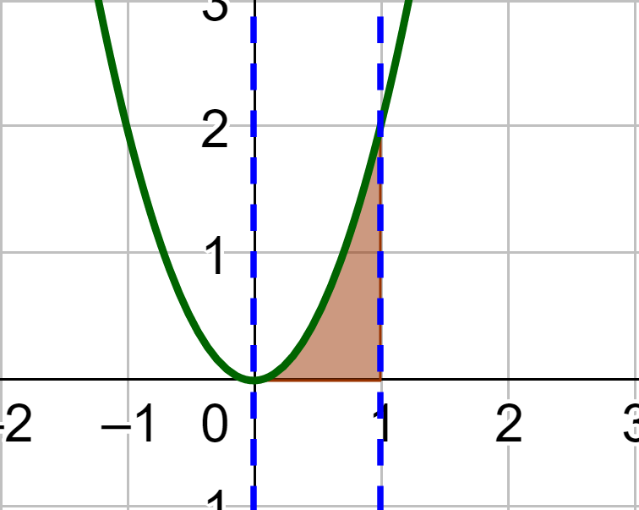
12-05 Integrals
Find the area bounded by $f\left(x\right)=2x^{2}$ and $x=0$ and $x=1$
Notes:
$$\int_{0}^{1}{2x^{2}}dx=\lim_{n→∞}{\sum_{i=1}^{n}{f\left(a+\frac{b−a}{n}i\right)\left(\frac{b−a}{n}\right)}}$$
Plug in a and b
$$\lim_{n→∞}{\sum_{i=1}^{n}{f\left(0+\frac{1−0}{n}i\right)\left(\frac{1−0}{n}\right)}}$$
$$\lim_{n→∞}{\sum_{i=1}^{n}{f\left(\frac{i}{n}\right)\left(\frac{1}{n}\right)}}$$
Plug in $f\left(x\right)$
$$\lim_{n→∞}{\sum_{i=1}^{n}{2{\left(\frac{i}{n}\right)}^{2}\left(\frac{1}{n}\right)}}$$
$$\lim_{n→∞}{\sum_{i=1}^{n}{\frac{2i^{2}}{n^{3}}}}$$
Factor out non i’s
$$\lim_{n→∞}\left(\frac{2}{n^{3}}\right)\sum_{i=1}^{n}{i^{2}}$$
Apply sum formula
$$\lim_{n→∞}\left(\frac{2}{n^{3}}\right)\left(\frac{2n^{3}+3n^{2}+n}{6}\right)$$
$$\lim_{n→∞}\left(\frac{4n^{3}+6n^{2}+2n}{6n^{3}}\right)$$
Evaluate
$$=\frac{4}{6}=\frac{2}{3}$$

Slide 32
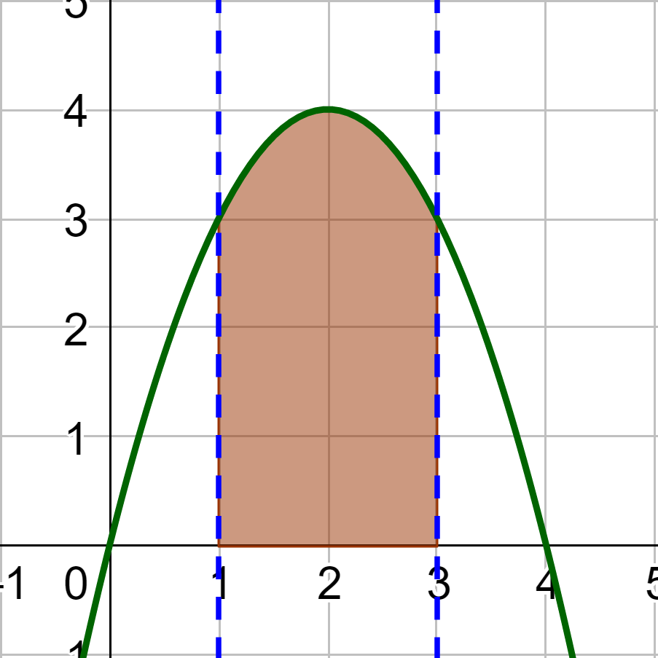
12-05 Integrals
Find the area bounded by $f\left(x\right)=4x−x^{2}$ and $x=1$ to $x=3$
Notes:
$$\int_{1}^{3}{4x−x^{2}}dx=\lim_{n→∞}{\sum_{i=1}^{n}{f\left(a+\frac{b−a}{n}i\right)\left(\frac{b−a}{n}\right)}}$$
Plug in a and b
$$\lim_{n→∞}{\sum_{i=1}^{n}{f\left(1+\frac{3−1}{n}i\right)\left(\frac{3−1}{n}\right)}}$$
$$\lim_{n→∞}{\sum_{i=1}^{n}{f\left(1+\frac{2i}{n}\right)\left(\frac{2}{n}\right)}}$$
Plug in $f\left(x\right)$
$$\lim_{n→∞}{\sum_{i=1}^{n}{\left(4\left(1+\frac{2i}{n}\right)−{\left(1+\frac{2i}{n}\right)}^{2}\right)\left(\frac{2}{n}\right)}}$$
$$\lim_{n→∞}{\sum_{i=1}^{n}{\left(4+\frac{8i}{n}−\left(1+\frac{4i}{n}+\frac{4i^{2}}{n^{2}}\right)\right)\left(\frac{2}{n}\right)}}$$
$$\lim_{n→∞}{\sum_{i=1}^{n}{\left(3+\frac{4i}{n}−\frac{4i^{2}}{n^{2}}\right)\left(\frac{2}{n}\right)}}$$
$$\lim_{n→∞}{\sum_{i=1}^{n}{\left(\frac{6}{n}+\frac{8i}{n^{2}}−\frac{8i^{2}}{n^{3}}\right)}}$$
Apply the Associative Property and Factor non i’s
$$\lim_{n→∞}\left(\sum_{i=1}^{n}{\frac{6}{n}}+\sum_{i=1}^{n}{\frac{8i}{n^{2}}}−\sum_{i=1}^{n}{\frac{8i^{2}}{n^{3}}}\right)$$
$$\lim_{n→∞}\left(\frac{6}{n}\sum_{i=1}^{n}{1}+\frac{8}{n^{2}}\sum_{i=1}^{n}{i}−\frac{8}{n^{3}}\sum_{i=1}^{n}{i^{2}}\right)$$

Slide 33
12-05 Integrals
$$\lim_{n→∞}\left(\frac{6}{n}\sum_{i=1}^{n}{1}+\frac{8}{n^{2}}\sum_{i=1}^{n}{i}−\frac{8}{n^{3}}\sum_{i=1}^{n}{i^{2}}\right)$$
Notes:
Apply the sum formulas
$$\lim_{n→∞}\left(\frac{6}{n}\left(n\right)+\frac{8}{n^{2}}\left(\frac{n^{2}+n}{2}\right)−\frac{8}{n^{3}}\left(\frac{2n^{3}+3n^{2}+n}{6}\right)\right)$$
$$\lim_{n→∞}\left(6+\left(\frac{8n^{2}+8n}{2n^{2}}\right)−\left(\frac{16n^{3}+24n^{2}+8n}{6n^{3}}\right)\right)$$
Separate into individual limits
$$\lim_{n→∞}{6}+\lim_{n→∞}\left(\frac{8n^{2}+8n}{2n^{2}}\right)−\lim_{n→∞}\left(\frac{16n^{3}+24n^{2}+8n}{6n^{3}}\right)$$
Evaluate
$$=6+\frac{8}{2}−\frac{16}{6}$$
$$=6+4−\frac{8}{3}$$
$$=\frac{22}{3}$$

